Slide 1
EMBRYONIC PERIOD
The first two months of pregnancy.
All adult organs are in place by the end of the embryonic period.
Once the blastocyst becomes implanted, the primary germ layers become formed.
The primary germ layers include; ectoderm, mesoderm & endoderm (embryonic disc).
These layers differentiate into what will become the adult tissue & organs.

Slide 2
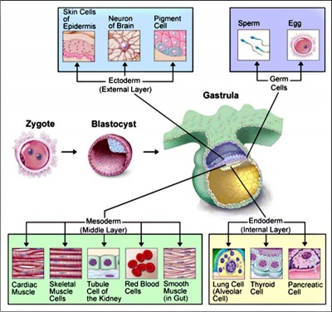

Slide 3
EMBRYONIC MEMBRANES
Amnion, yolk sac, allantois and chorion are the embryonic membranes that are formed.
Amnion acts as a “shock absorber” (formed 8 days after fertilisation & surrounds the embryo).It secretes amniotic fluid into the amniotic cavity.
Chorion forms foetal part of the placenta (chorionic villi- formed by trophoblast cells & one layer of mesoderm). Releases HCG.
Yolk sac- first site of red blood cell production.
Yolk sac & allantois end up forming the umbilical cord (body stalk).

Slide 4
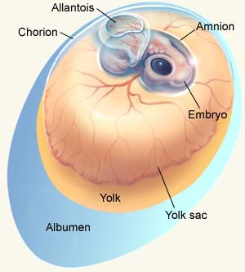

Slide 5
GERM LAYERS BECOME ORGANS & TISSUE
Ectoderm- becomes skin, hair, nervous tissue & the lining of the respiratory & digestive systems
Endoderm- becomes pancreas, liver, bladder & thyroid gland.
Mesoderm- becomes the skeletal, muscular, cardiovascular, lymphatic, urinary & reproductive systems

Slide 6
EMBRYONIC MILESTONES
By 3 weeks, the blood & blood vessels start developing. Notochord (future spinal cord) is formed.
By 4 weeks, muscle segments are formed around the future brain and spinal cord.Tail formed. Major organs start developing.
By 5 weeks, the arm & leg buds are evident. Eyes & ears start to form. Face evident.
By 6 weeks, umbilical cord formed. Skeleton formed.

Slide 7
EMBRYONIC MILESTONES Cont...
By week 7, head is round. Eyes large. Hands & feet formed. Skeleton growth occurs. Tail gone.
By week 8, gender can be determined by chorionic villus sampling. All organs are formed but not necessarily functioning. First movements of finger/ toes/ arms/ legs. Face is formed.

